Slide 1
Data Structures and Algorithms
Lecture 05
Manish Aryal

Slide 2
Data Structures and Algorithms
Key Learning Points
List
A linear list is a data structure each element of which has a unique successor
Operations
Insertion
The process of adding data to the list
Deletion
Is the process of searching and removing data from the list
Retrieval
also requires list searching, but does not change the contents of the list.
Traversal
is retrieval of all elements in sequence
General List, Restricted list
element 1
element 2
element 3

Slide 3
Linked List
Contents
Dynamic Implementation
Operations in linked list
Linked Stacks and Queues
Doubly Linked List and its applications

Slide 4
Linked List
Objectives
After completion of this chapter you will be able to:
Define a linked list as a Data Structure
Define its dynamic implementation
Explain various operations used in Linked List
Implement Stack and Queue as linked list
Define and implement Doubly Linked List
Attempt 10 marks’ question in final exams

Slide 5
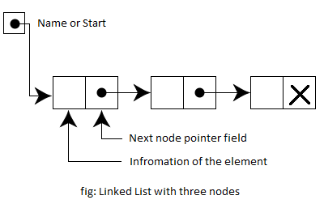
Linked List
Definition
A linked list or one-way list, is a linear collection of data elements called as nodes, where the linear order is given by means of a pointer
That is, each node is divided into two parts:
The first part contains the information of element
The second part contains

Slide 6
Linked List
Definition {Contd..}
The data items need not be stored continuously in memory or on disk
The list elements can easily be added or removed without reallocation or reorganization of the entire structure
Linked lists allow insertion and removal of nodes at any point in the list, and can do so with a constant number of operations if the link previous to the link being added or removed is maintained during list traversal
On the other hand, simple linked lists by themselves do not allow random access to the data other than the first node's data, or any form of efficient indexing
Thus, many basic operations may require scanning most or all of the list elements

Slide 7
Linked List
Operations
Create
Declaring and initializing a linked list
Insert
The process of adding data to the list
Delete
Is the process of searching and removing data from the list
Retrieve
also requires list searching, but does not change the contents of the list.
Traverse
is retrieval of all elements in sequence

Slide 8
Linked List
Operations {Contd..}
Create
struct node
{
<data type> info;
struct node *next;
};
void create(){
struct node *p=(NODE *)malloc(sizeof(NODE));
if(p)
{
printf(“Enter an Element:”);
sacnf(“%d”, &p->info);
P->next=NULL;
}
return p;}

Slide 9
Linked List
Operations {Contd..}
Insertion
Insertion in the list come up in various situations
The major situations include:
Insertion at the beginning of the list
Insertion at the end of the list
Insertion after a given node

Slide 10
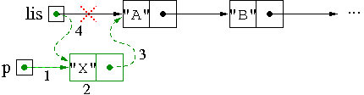
Linked List
Operations {Contd..}
Insertion the beginning of the list
allocate a new node for the element (note that we are given the element (e.g., a string)
assign the element to the info instance field
concatenate the new node with the original list,
make the newly created node the first one of the list
insertFirst(ListNode lis, String s)
{
ListNode p = new ListNode();
p.info = s;
p.next = lis;
lis = p;
return lis;
}

Slide 11
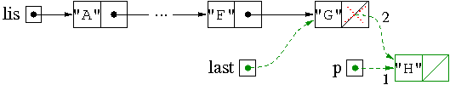
Linked List
Operations {Contd..}
Insertion at the end of the list
create a new node whose info field is elem;
if (lis is empty)
return the list constituted only by the new node;
Else
scan the list stopping when the current reference points to the last node concatenate the new node with the last one
insertLast(ListNode lis, String s)
{
ListNode p = new ListNode();
p.info = s;
if (lis == null)
return p;
else
{
ListNode last = lis;
while (last.next != null)
last = last.next;
Last.next = p;
return lis;
}
}

Slide 12
Linked List
Operations {Contd..}
Insertion after a given node
??

Slide 13
Linked List
Operations {Contd..}
Deletion
In general, deleting an element of a list means to modify the list in such a way that the element is no longer connected to its predecessor and successor
Deletion may occur in following situations
Delete from the beginning of the list
Delete from the end of the list
Delete a given node

Slide 14

Linked List
Operations {Contd..}
Deletion from the beginning of the list
If the list is empty, don't do anything.
Otherwise, return the list starting at the element that follows the first one
deleteFirst(ListNode lis)
{
if (lis != null)
lis = lis.next;
return lis;
}

Slide 15
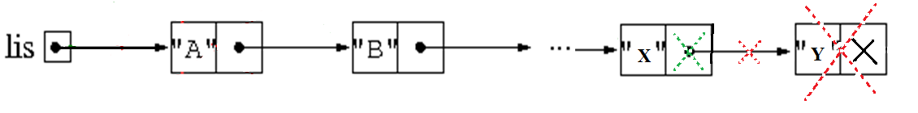
Linked List
Operations {Contd..}
Deletion from the end of the list
if (lis is empty)
return empty;
Else
scan the list stopping when the current reference points to the last node
Set the pointer to NULL

Slide 16
Linked List
Operations {Contd..}
Deletion of a given node
??

Slide 17
Next Lecture: Linked List {Contd..}
Thank You.

